Slide 1
WELCOME! CSE Outreach Roadshow
School of Engineering
University of South Florida

Slide 2



Who We Are
Jing Wang, Ph.D.
Instructor II
Department of Computer
Science
and Engineering
University of South Florida
Meryem Berrada,
President of WICSE (Women In Computer Science and Engineering)
University of South Florida
Elisabeth Marsh,
Vice-President of WICSE (Women In Computer Science and Engineering)
University of South Florida

Slide 3
What is Computer Science?

Slide 4
What is Computer Science?
Using computers to solve problems!

Slide 5
What is Computer Science?
Computer science is a fast-moving field that
brings together many disciplines, including
medicine, social science engineering,
the natural sciences, education, psychology
and linguistics.
Social Science
Medicine
Engineering
Computer
Science
Computer
Science
Natural
Sciences
Linguistics
Psychology

Slide 6

Computer Software
Computer software is any set of machine-readable
instructions that directs a computer's
processor to perform specific
operations.

Slide 7
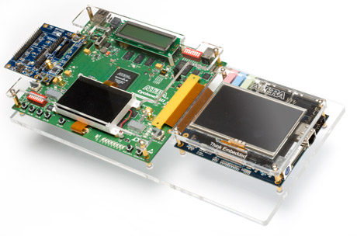
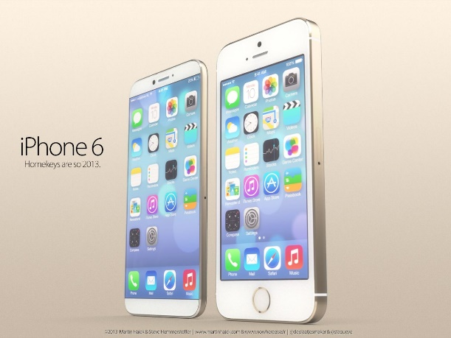
Computer Hardware
Computer hardware is the collection of physical elements that constitutes a computer system. Computer hardware refers to the physical parts or components of a computer.
http://www.altera.com/products/devkits/altera/kit-emb-dev-cyc3.html
http://www.cultofmac.com/252779/gold-iphone-6-concept-gallery/

Slide 8
Applications of Computer Science
Problem Solving
Computer Security
Human computer interaction
Computer graphics, art, and animation
Algorithms

Slide 9
Problem Solving

Slide 10
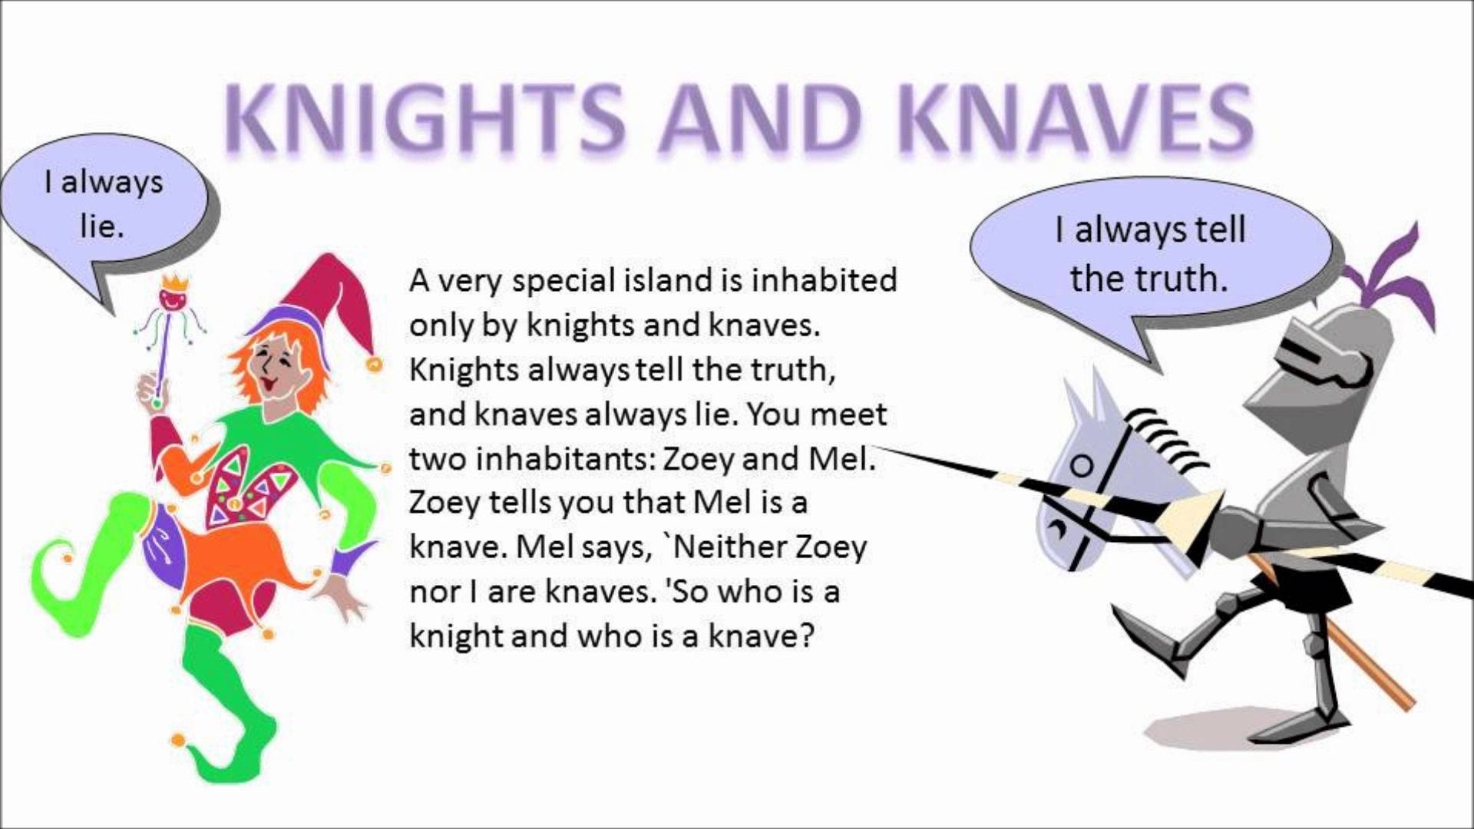
Problem Solving
CHANGE THIS PROBLEM TO A KNIGHTS AND KNAVES PROBLEM WHERE THERE IS MORE DIALOG (So that can have to students act it)
http://www.youtube.com/watch?v=C83ozUgRbBA

Slide 11
Many Computer Scientists Work on Internet Safety

Slide 12

Computer Security
Computer Security is the protection of computer systems and devices, including the data that they store
HOW??
http://www.foregolfproperties.com/impacted-38-tax-selling-home/confused-figure-with-question-marks/

Slide 13
Cryptography
Key
A = N
B = O
C = P
D = Q
E = R
F = S
G = T
H = U
I = V
J = W
K = X
L = Y
M = Z
N = M
O = L
P = K
Q = J
R = I
S = H
T = G
U = F
V= E
W= D
X= C
Y = B
Z = A
Cryptography is the method of storing and transmitting data in a particular form so that only those for whom it is intended can read and process it.
Encode a message about a location for a meeting using the chart on the right.
Exchange the encrypted sentence with your neighbor and decode his/her message.
Notes:
13

Slide 14
Can you decode this ?
Key
A = N
B = O
C = P
D = Q
E = R
F = S
G = T
H = U
I = V
J = W
K = X
L = Y
M = Z
N = M
O = L
P = K
Q = J
R = I
S = H
T = G
U = F
V= E
W= D
X= C
Y = B
Z = A
Plzkfgri hpvrmpr vh sfm

Slide 15
Can you decode this ?
Key
A = N
B = O
C = P
D = Q
E = R
F = S
G = T
H = U
I = V
J = W
K = X
L = Y
M = Z
N = M
O = L
P = K
Q = J
R = I
S = H
T = G
U = F
V= E
W= D
X= C
Y = B
Z = A
Plzkfgri Hpvrmpr vh sfm !
Computer Science is fun !

Slide 16
What does Computer Science have to do with Art?

Slide 17

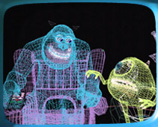


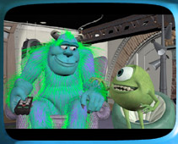

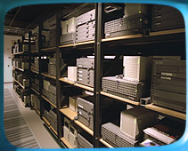
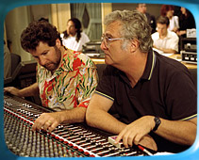
Monster Inc. by Pixar
Animation: Production Pipeline
Storyboards
Modeling
Shading and Texturing
Lighting
Rendering
Animation
Post Production
http://www.pixar.com/howwedoit/index.html

Slide 18
Video: Student Project in CAP4034 (Computer Animation Course at USF)
ADD ANIMATION VIDEO HERE

Slide 19
Algorithms

Slide 20
What is the similarity between these?
Cooking recipe
Car repair manual
Knitting pattern
Sheet music
Notes:
They are, or involve, lists/sequences of instructions
The instructions are either explicit, maybe in different forms (recipe, repair manual, knitting pattern, sheet music) or implicit (calling a friend on the phone)
In fact, pretty well EVERYTHING we do can be written as some form of steps/instructions

Slide 21
Why discuss lists of instructions here??
Computer programs are lists of instructions
with very particular characteristics
known as algorithms
How many of you know of a famous computer error/mistake?
HERE INSERT NASA EXAMPLE: 1 PIC AND ONE OR TWO SENTENCE describing what happened and why it happened?
Notes:
Famous errors:
Airbus: designed to start landing sequence at 50m height. But what happens if pilot showing off – as happened at Paris airshow…
Ariane 5: used same software as Ariane 4 for guidance. But Ariane 5 goes faster – so when guidance software got speed data from sensors, it assumed an error, and sent error information on up the system, which was inpreted as real (but obviously crazy) data higher up – causing rocket to choose to self-destruct
Early space probe (Mariner 7??): a single semi-colon in the wrong place gave the wrong meaning, and so spacecraft stayed in orbit forever rather than igniting rockets to head off somewhere else
Jet fighter – flipped upside down when it went over the equator, because it didn't allow for negative latitude readings.

Slide 22
Why discuss lists of instructions here??
These are caused by the wrong instructions in the program
the instructions were interpreted by the computer in a way not intended by the program designer
We are going to explore how these errors come about
Notes:
Famous errors:
Airbus: designed to start landing sequence at 50m height. But what happens if pilot showing off – as happened at Paris airshow…
Ariane 5: used same software as Ariane 4 for guidance. But Ariane 5 goes faster – so when guidance software got speed data from sensors, it assumed an error, and sent error information on up the system, which was inpreted as real (but obviously crazy) data higher up – causing rocket to choose to self-destruct
Early space probe (Mariner 7??): a single semi-colon in the wrong place gave the wrong meaning, and so spacecraft stayed in orbit forever rather than igniting rockets to head off somewhere else
Jet fighter – flipped upside down when it went over the equator, because it didn't allow for negative latitude readings.

Slide 23
Following an Algorithm
Algorithm written on hand-out
to draw a picture
You cannot ask for any help
Don't look at your classmates work
do it by yourself!!!

Slide 24
Here's the algorithm – follow exactly!!
Draw a diagonal line
Draw another diagonal line connected to the top of the first one
Draw a straight line from the point where the diagonal lines meet
Draw a horizontal line over the straight line
At the bottom of the straight line, draw a curvy line
Draw a diagonal line from the bottom of the first diagonal to the straight line
Draw a diagonal line from the bottom of the second diagonal to the straight line
Notes:
Only need to use this slide if they don't have the hand-out.

Slide 25
It was meant to be a kite!!
Draw a diagonal line
Draw another diagonal line connected to the top of the first one
Draw a straight line from the point where the diagonal lines meet
Draw a horizontal line over the straight line
At the bottom of the straight line, draw a curvy line
Draw a diagonal line from the bottom of the first diagonal to the straight line
Draw a diagonal line from the bottom of the second diagonal to the straight line
Notes:
In a jokey fashion, show how the instructions "obviously" give us a kite!! (step through the animation of the kite picture).

Slide 26
Sorting Algorithms
Sorting is the process of arranging a list of items in a particular order
There are many algorithms, which vary in efficiency, for sorting a list of items
We will examine two specific algorithms:
Selection Sort
Insertion Sort

Slide 27
Sorting Algorithms
Selection-Sort
find the smallest value in the list
switch it with the value in the first position
find the next smallest value in the list
switch it with the value in the second position
repeat until all values are in their proper places

Slide 28
Sorting Algorithms
Insertion-Sort
consider the first item to be a sorted sublist (of one item)
insert the second item into the sorted sublist, shifting the first item as needed to make room to insert the new addition
insert the third item into the sorted sublist (of two items), shifting items as necessary
repeat until all values are inserted into their proper positions

Slide 29




Does your computer ever make you feel like this?
Notes:
29
29

Slide 30

Computer scientists can help!
Notes:
30
30

Slide 31


Human-Computer Interaction
Design, Psychology, Computer Science

Slide 32
What field has …?
The best-rated job, and 5 of the top 10 highest paid ?
Shown strong job growth ?
Can help make the world a better place ?

Slide 33
ADD SLIDE FOR FUN ROLES IN CSE THAT YOU CAN HAVE

Slide 34







Graduates Could Work Here!
Slide too busy . reformat
Hardware & Software:
Microsoft
Dell
Sun
IBM
Intel
Boeing
Apple
DoD
Web:
Google
Microsoft
Amazon
Facebook
Yahoo
Finance:
Goldman Sachs
Morgan Stanley
Merrill Lynch
Consulting:
Accenture
Deloitte & Touche
PricewaterhouseCoopers
Arts & Entertainment:
Lucas Arts Film Company
Pixar Animation Studios
Walt Disney Imaging
…and Start-Ups or Grad School
Notes:
34
34

Slide 35
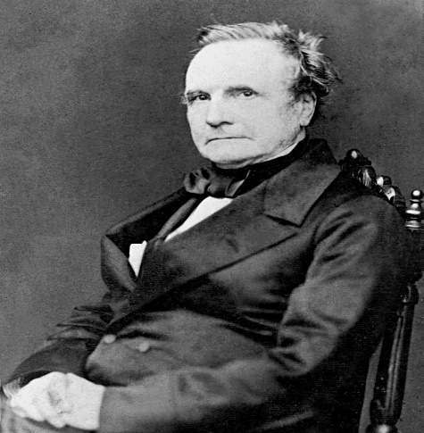
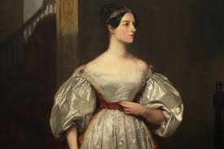
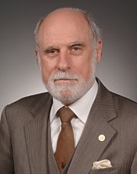
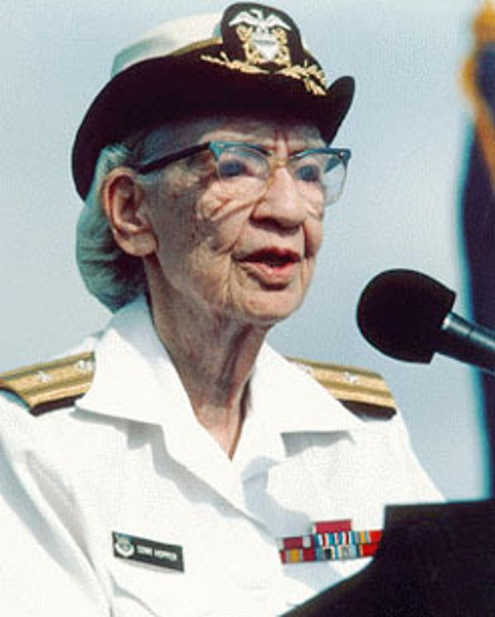
Major CSE Contributors
Charles Babbage, build the difference engine
Ada Lovelace, First programmer
Vinton Cerf, Father of the Internet
Grace Hopper, Inventor of compilers

Slide 36
Shortage in female graduates (reformulate this to sth more positive
The number of women in CS peaked in the mid-1980s, and has declined ever since.
In 1984, 37.1% of undergraduate CS degrees were awarded to women.
In 2012, it was 12.9%.
In the mid-1980s, women represented 38% of the computing and information technology workforce.
Today it stands at about 25%.

Slide 37
Who We Are
WICSE (Women in Computer Science and Engineering)
We are a group that is focused on gathering together female students who are majoring, or interested in, computer science and engineering to provide support, career guidance, opportunities to discuss relevant topics and social outings!

Slide 38
Resources
http://www.priscilla.com/womehownincs.pdf
Some slides are derived from: http://women.cs.cmu.edu/What/Outreach/Roadshow/
Computer Science Unplugged http://csunplugged.org/
Computer Science for Fun http://www.cs4fn.org/

Slide 39
Thank you!
Questions?

